Slide 1

Historical analysis of stocks,
to evaluate growth, fluctuation, risk, and potential future performance.
Authors: Cesar Zea, Xingjia Wang,
Angelo,
Levan Getia
July 2023

Slide 2
Introduction and Methodology
Project Outline: We aim to analyze historical stock data to identify stocks with the highest percentage price changes, lowest standard deviation, and a combination of both. Additionally, we predict future prices and compare them with real-time data.
Methodology: We have used Python with Pandas, NumPy, Matplotlib, and SciPy for data analysis, as well as linear regression for future price prediction. Additionally, we used a real-time stock data API for comparison.
Project Usage: Young investors are seeking information to choose stocks for investment. The DIY investment trend is growing*. Based on this, evaluating different stocks to find the right ones for growth while considering the risk aversion of investors is important.
*https://www.mackenzieinvestments.com/en/investments/by-type/etfs/etf-articles/the-growth-in-diy-investors#:~:text=In%202020%2C%20Canadians%20opened%20over,investors%20often%20make%20avoidable%20mistakes.

Slide 3
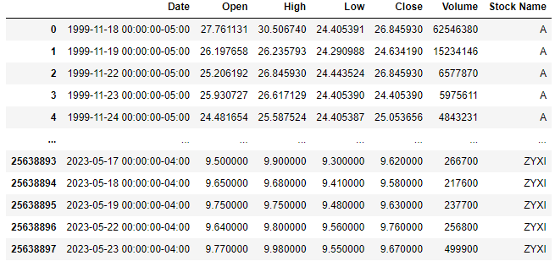
Data Collection and Preparation
Data Retrieval: All of the data used is provided by the NASDAQ index*. The database file was retrieved from kaggle.com, and the stock files are presented in .csv format. The code analyses all the files in .csv format that are located in the ‘Stocks’ directory. These files include Date, Price, Open, Close, Volume, and Stock Name. Some columns were deleted as part of the data cleaning process.
Data cleaning: To ensure the robustness of our analysis, we performed several data cleaning steps. These steps included merging the data into one data frame, deleting empty columns, and ensuring that each column has the proper data type. For example, we converted the 'Date' column to datetime format for time series analysis. After completing these steps, we had clean and usable data ready for analysis.
*https://www.kaggle.com/datasets/bryanb/cac40-stocks-dataset?resource=download

Slide 4
Analysis – Retrieving top 20 stock with highest price change
Stock Name | Percentage Change | R-squared | std
SCM | 199.52 | 0.76 | 0.14
LFUS | 199.25 | 0.75 | 3.28
DRS | 199.20 | 0.72 | 0.22
INFU | 198.63 | 0.52 | 0.28
TRUP | 198.33 | 0.59 | 2.10
ROK | 198.30 | 0.82 | 2.72
RRR | 198.04 | 0.45 | 0.67
USPH | 197.86 | 0.54 | 1.80
AU | 197.77 | 0.48 | 0.40
IRT | 197.69 | 0.78 | 0.21
CLFD | 197.61 | 0.49 | 1.39
DKL | 197.52 | 0.67 | 0.60
KFRC | 197.46 | 0.78 | 0.73
PH | 197.14 | 0.84 | 3.08
CLH | 196.70 | 0.74 | 1.32
CPK | 196.62 | 0.92 | 1.39
ELS | 196.03 | 0.89 | 0.77
HQI | 195.85 | 0.57 | 0.36
PLUG | 195.64 | 0.42 | 0.73
FERG | 195.59 | 0.76 | 0.90
Stock selection for analysis: Since the dataset offered by the NASDAQ index is very extensive and includes historical data from the 90’s, we decided to avoid any misconceptions or usage of unchecked data by selecting only the data from the last 8 years. This interval provides the most relevant information for predicting stock volatility or price gains.
The final data frame shows the top 20 stocks based on price growth of up to 200%.
Table Description: Stocks are ranked in descending order from highets price change
to the lowest.

Slide 5
Analysis – top 5 stocks with categories
Top 5 stocks with highest price gain
(ordered by Percentage Change)
Stock Name | Percentage Change | R-squared | std
SCM | 199.52 | 0.76 | 0.14
LFUS | 199.25 | 0.75 | 3.28
DRS | 199.20 | 0.72 | 0.22
INFU | 198.63 | 0.52 | 0.28
TRUP | 198.33 | 0.59 | 2.10
Top 5 stocks with strong growth AND stability
(ordered by R-squared)
Stock Name | Percentage Change | R-squared | std
CPK | 196.62 | 0.92 | 1.39
ELS | 196.03 | 0.89 | 0.77
PH | 197.14 | 0.84 | 3.08
ROK | 198.30 | 0.82 | 2.72
KFRC | 197.46 | 0.78 | 0.73
Top 5 stocks with lowest variability (ordered by std)
Stock Name | Percentage Change | R-squared | std
SCM | 199.52 | 0.76 | 0.14
IRT | 197.69 | 0.78 | 0.21
DRS | 199.20 | 0.72 | 0.22
INFU | 198.63 | 0.52 | 0.28
HQI | 195.85 | 0.57 | 0.36

Slide 6
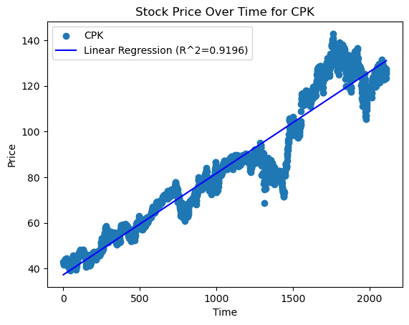
Analysis – visualizing stock price movements with scatter plots
Top stock performer in terms of growth AND stability
This graph indicates steady growth for CPK stock. Although there is some variance, CPK shows strong potential for price improvement with low variability and high predictability. Our prediction suggests a price increase of 19.72 USD in one year (May 2024).
The project/code provides scatter plots and price differential predictions for all the stocks that were included as the top 20 stocks in terms of price gains.

Slide 7
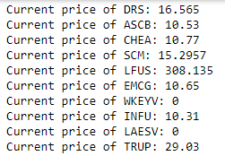
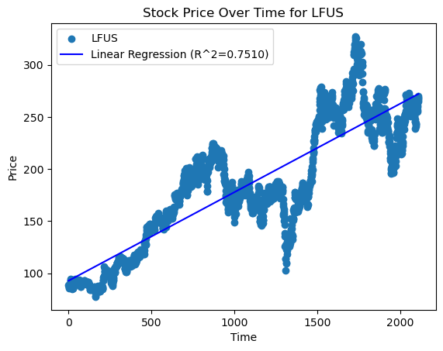
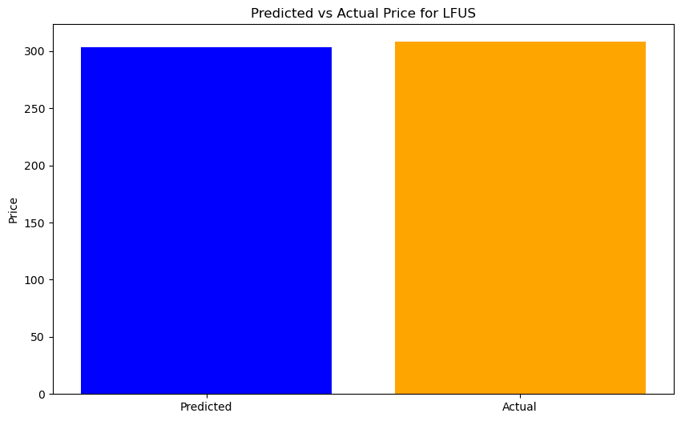
Real time comparison and future price predictions
Current price retrieval through Finnhub API
The code connects with the Finnhub server and retrieves current prices for the top stocks.
The project/code compares the predicted price for the stocks to the actual one and generates a histogram visualization of the differences.

Slide 8
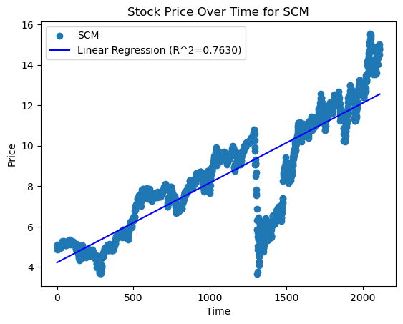
Summary of Findings
Volatility in stocks
According to our findings, volatility does not necessarily determine the success or failure of a stock. For instance, stock SCM was one of the best performers, yet encountered very low volatility. On the other hand, PH could not perform as well, but experienced higher volatility.
According to the analysis gathered through our project, we can define volatility as risk, given that prices vary to a higher extent. However, it is not tied to the performance of a stock but rather to the peace of mind of an investor.
Based on this information we can suggest the top 5 stocks based on:
Only on price:
SCM, LFUS, DRS, INFU, TRUP
The top stocks based on price stability (Standard deviation):
SCM, IRT, DRS, INFU, HQI
And the top based on price AND stability (R-squared):
CPK, ELS, PH, ROK, KFRC

Slide 9
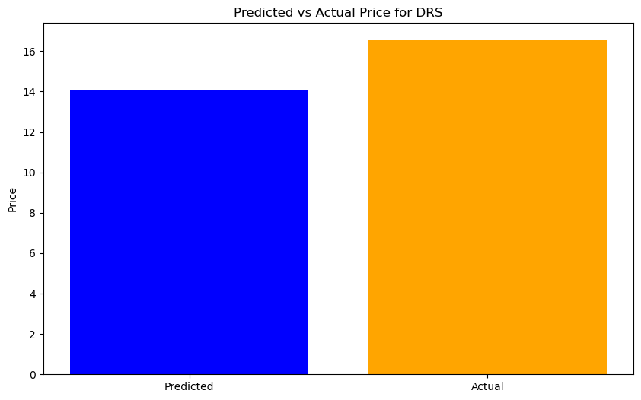
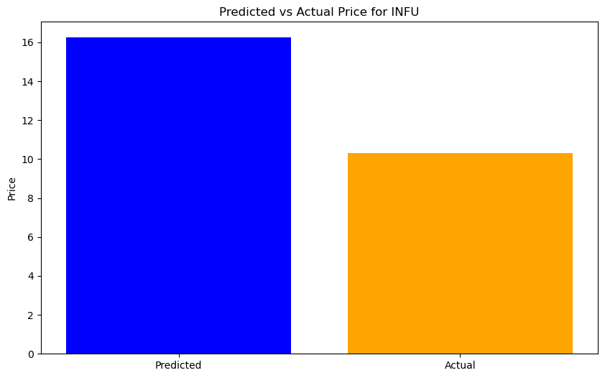
Limitations of the project
This project should only be used as a guideline for selecting stocks with less or more risk/volatility. If an investor agrees with our view that more price volatility means more risk, they can differentiate stocks on the NASDAQ index based on factors such as the least price volatility over the past years, the highest price gain disregarding volatility, and more. However, our price prediction model is not exact and should be only used as input for decision making as other factors (beyond historical performance) can/would influence final prices for the stock in one year.
This graphs are to illustrate that predicted price is not consistent with the actual

Slide 10
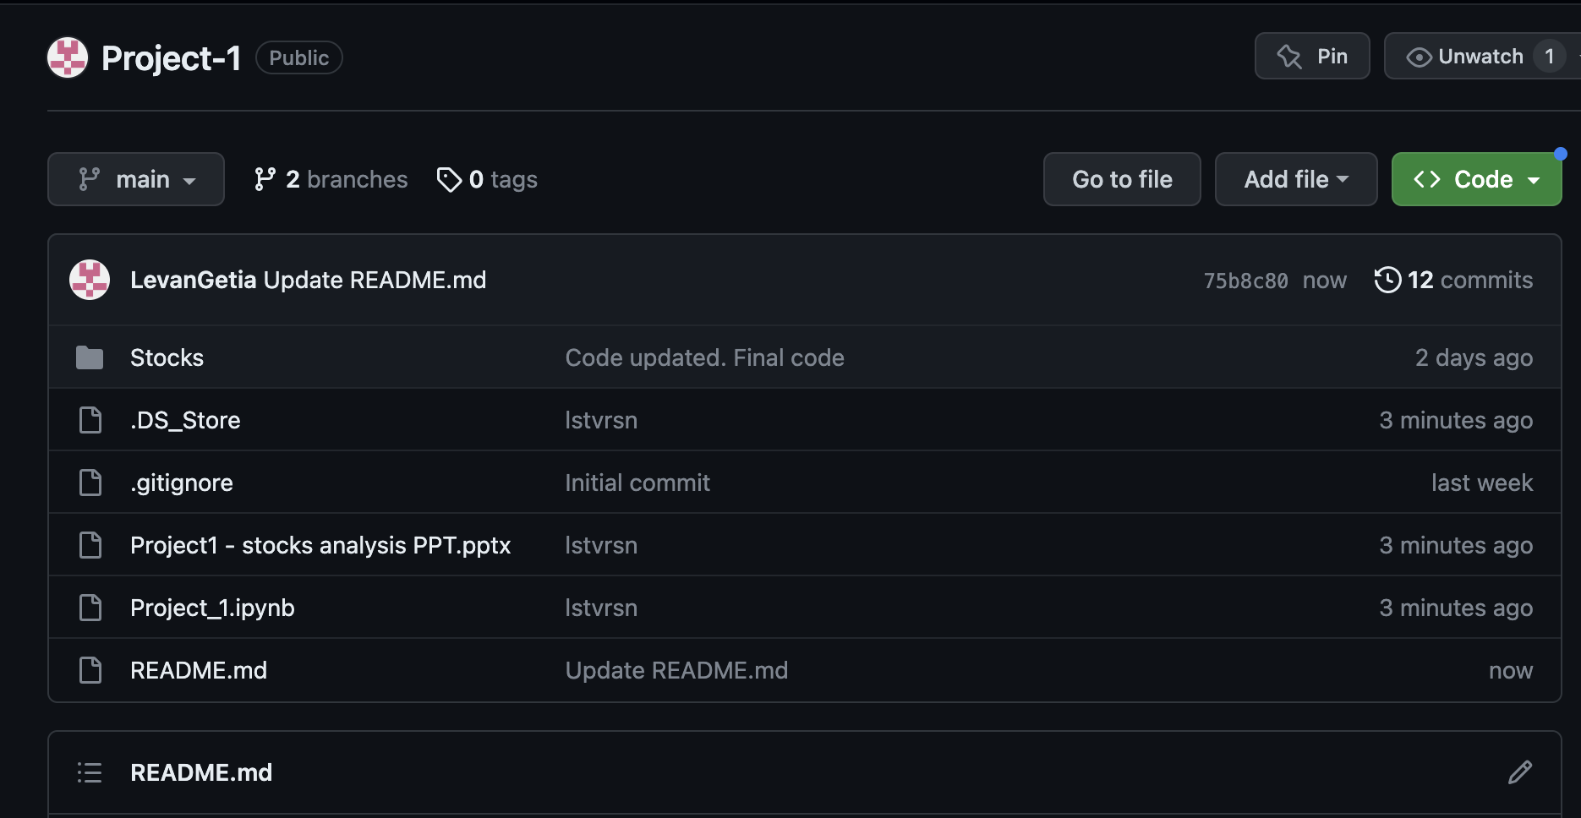
GitHub Repository and Readme
This is a screenshot of the GitHub repository for the project. The repository is public and easily accessible. Just clone it to your local machine, and it will be ready to run. The project comes with its own set of historical data; however, the 'Stocks' directory can be easily modified with other .csv format files that will fit the needs of a user.
Repo explanation:
The actual code file is in a Jupyter Notebook file called Project_1.ipynb.
The 'Stocks' directory contains .csv formatted data files.
Project1 - stocks analysis PPT - is the file for these slides.
The Readme file provides a brief overview of what is done by this project/code.
GitHub link: https://github.com/LevanGetia/Project-1

Slide 11
Thank you!
Cesar, Irene, Angelo and Levan
Thank you for you interest in this project and your time ☺

